Slide 1



API Development for Forecasting Solar Power Generation Using Weather Data
THE 33rd JOINT CONFERENCE ON COMMUNICATIONS AND INFORMATION
Presented by :
Muhammad Miftah Faridh
Department of Electronics Engineering
Kookmin University

Slide 2

Outline
General Overview
Motivation & Contribution
Methodology
System Overview
Result & Discussion
Conclusion

Slide 3


General Overview
Reliance on fossil fuels may lead to an energy crisis due to pollution and greenhouse gas emissions, making them unreliable as future energy sources.
To address the challenge of predicting solar irradiance for solar energy potential, models such as multi-regression and Artificial Neural Networks (ANN) have been developed
This research aims to use advanced ANN models, including LSTM, Bi-LSTM, RNN, and ConvLSTM, to forecast solar power generation using plant data and weather information.
A REST API will be created for output predictions, reducing deviations in solar power production and maintaining reliability with accurate forecasting from advanced ANN mode.

Slide 4
Motivation & Contribution
Weather & Energy Data
Comparison Model
Forecast Model
Rest API

Slide 5
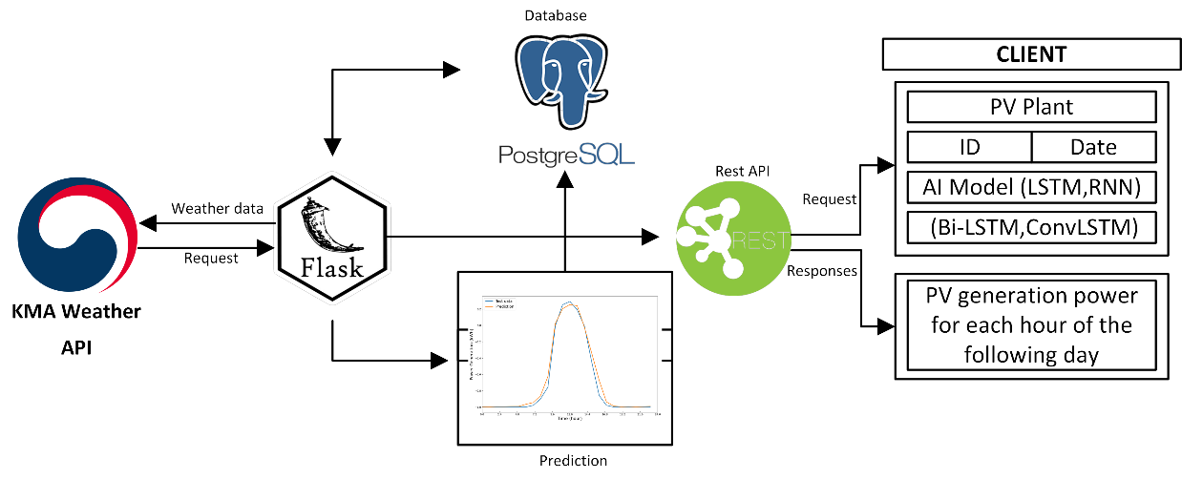
Methodology
We used
Fig. 1. System Overview

Slide 6
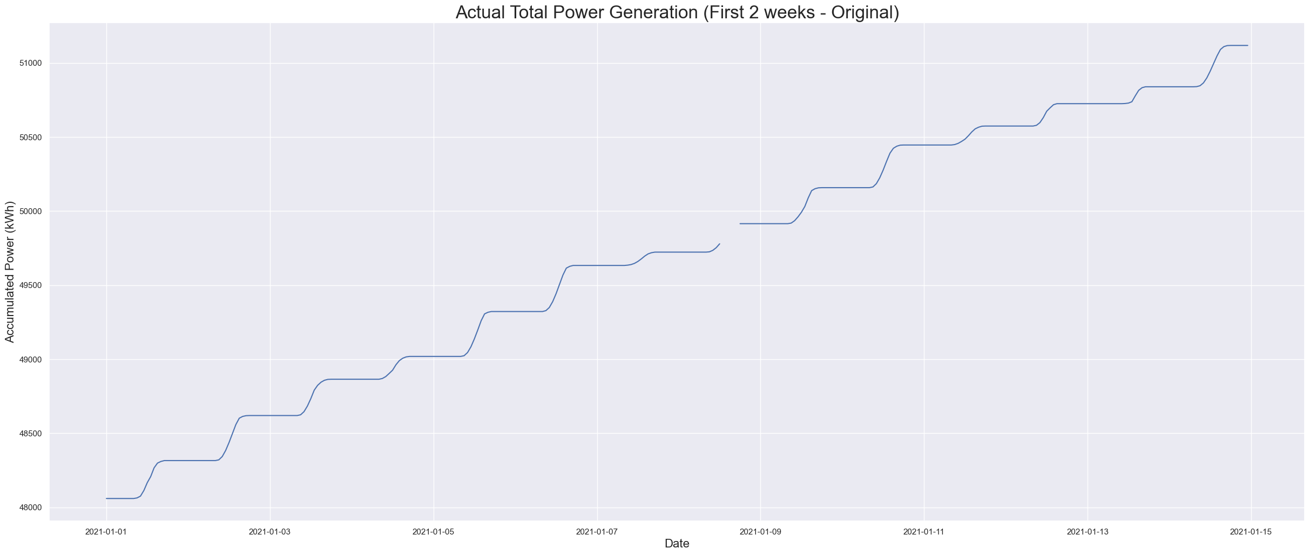

System Overview
Data Preprocessing
Interpolate Missing value using interpolation with linear method.

Slide 7
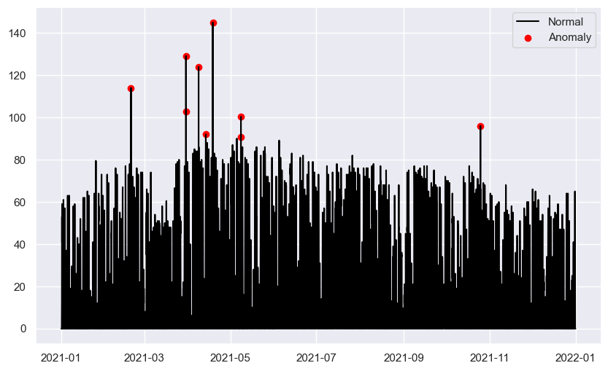
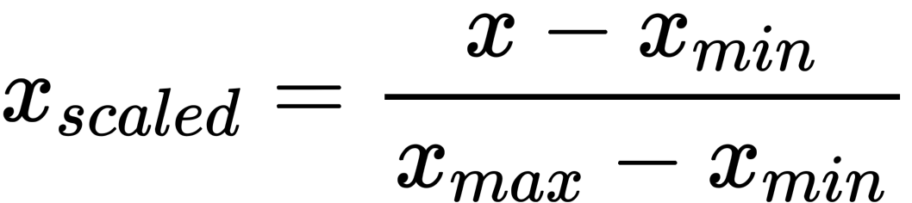
System Overview
Data Preprocessing
Deletion the outlier data and replace with nearest data
Then, the data are normalized using the MinMax method, the -1 to 1 rescaling approach

Slide 8
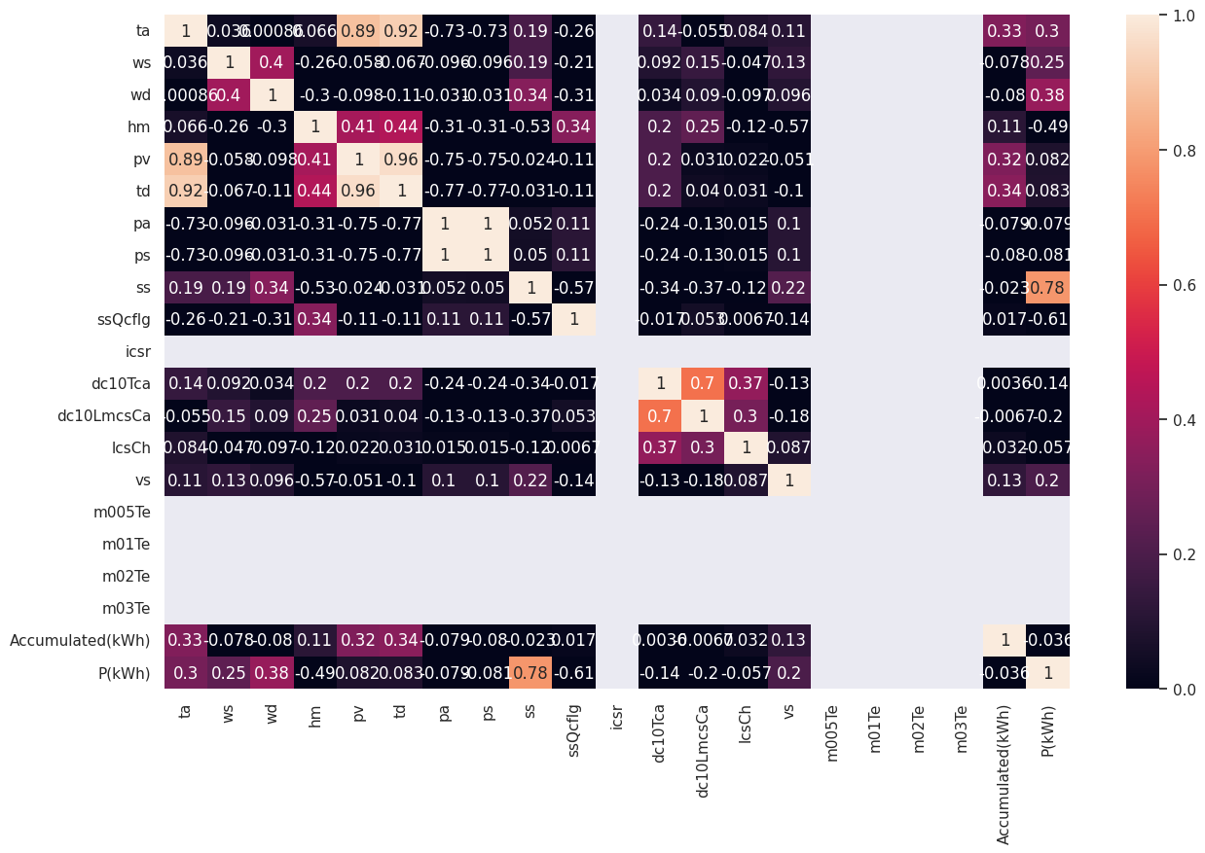
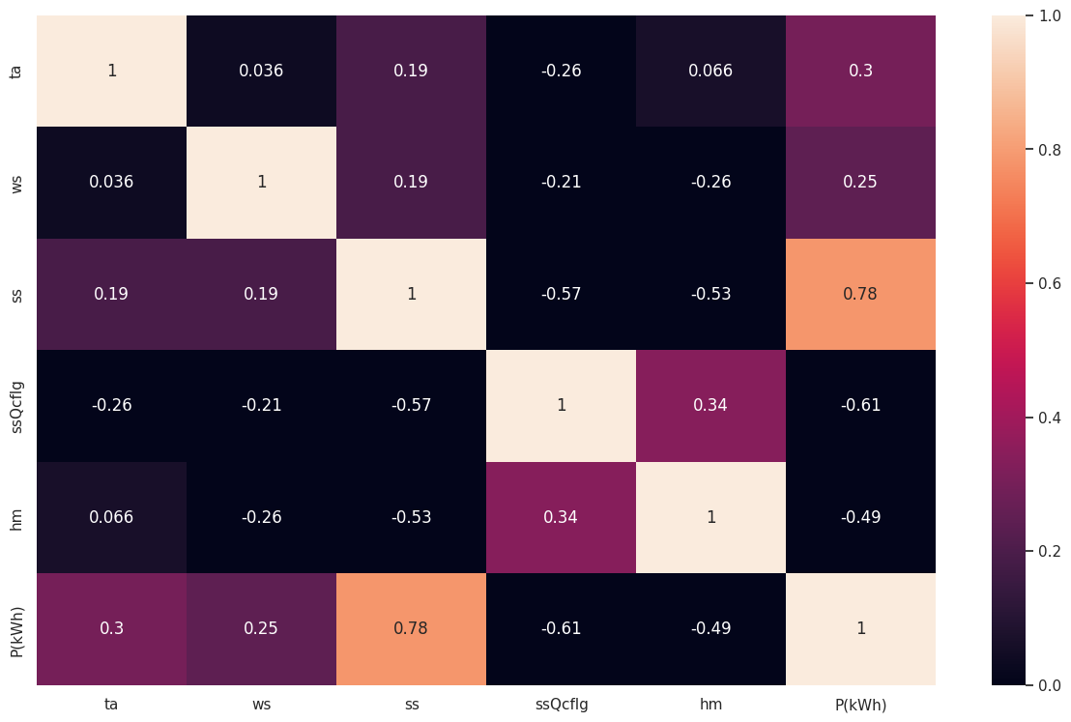
System Overview
Data Preprocessing
Correlation checking uses a correlation matrix and takes features that have the highest correlation, and we get temperature, relative humidity, solar radiation, sunshine in seconds per hour, and precipitation per hour as the highest correlation

Slide 9
System Overview
Data Preprocessing
1 Day
1 Day
Test Data
Train
Windows
Validation
Test
We used 1 day data to predict 1 day future data

Slide 10
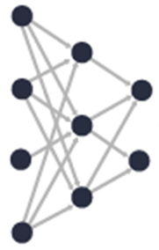
System Overview
Deep learning model based on Power Generation forecasting
Weather Data
Pre Processing
Forecast Trained Model
Power Generation Data
LSTM, Bi-LSTM, RNN, and ConvLSTM
The batch size is set to 128, Adam is used as the optimizer with a learning rate of 0.01, iterations are set to 10,000, and a callback function is used to end the experiment if the data has converged or is close to overfitting. This hyperparameter is applied to all models with the same treatment.

Slide 11
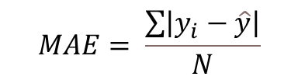
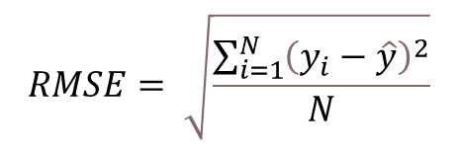
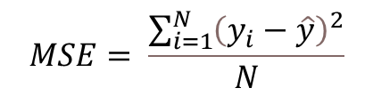
System Overview
Deep learning model evaluation
$$MSE= \frac{\sum_{i=1}^{N}{{\left(y_{i}−\hat{y}\right)}^{2}}}{N}$$
$$RMSE= \sqrt{\frac{\sum_{i=1}^{N}{{\left(y_{i}−\hat{y}\right)}^{2}}}{N}}$$
$$MAE= \frac{\sum{\left|y_{i}−\hat{y}\right|}}{N}$$
We have several discoveries related to the forecasted accuracy of time series data. The quality of the model is evaluated based on measures such as loss and validation loss. To assess the accuracy of the predictions, we utilized metrics like RMSE, mean absolute error (MAE), and mean square error (MSE). We calculated the error metrics using the equation above.

Slide 12
Result and Discussion
Model Performance
Bi-LSTM can capture both forward and backward dependencies, is robust to noise and missing data, and has flexibility in modeling complex relationships. However, the performance of Bi-LSTM may depend on the specific characteristics of the dataset and the choice of hyperparameters. LSTM, RNN, and Convolutional LSTM can perform less than Bi-LSTM on this power generation data due to their limitations in handling bidirectional dependencies, noisy and missing data, and complex relationships.
Model | MSE | RMSE | MAE
RNN | 0.023 | 0.1516 | 0.0979
LSTM | 0.0197 | 0.1404 | 0.088
ConvLSTM | 0.0265 | 0.1629 | 0.1117
BiLSTM | 0.0192 | 0.1387 | 0.0757

Slide 13
Result and Discussion

Slide 14
Conclusions
In this study, a comparative model was developed to predict solar power generated by PV power generation using weather data.
The Bi-LSTM model showed excellent performance across all evaluation metrics, as its learning process allows it to read both past and future data simultaneously.
Additionally, a REST API was created using Flask and tested successfully with Postman. The researchers aim to explore online training AI models in the future further to improve the deep learning models' performance over time.

Slide 15
Acknowledgment
This work was supported by the Technology development Program (S3098815) funded by the Ministry of SMEs and Startups (MSS, Korea).

Slide 16
Thank you

